Slide 1
CST3340 – Business Intelligence Performance Analysis and Data Mining of Premier League Teams (2016/17–2017/18)
Student Number | Student Name
M00809695 | Yasin Lester

Slide 2
Case Study: Performance analysis across premier league teams. of Premier League Teams Performance
The Premier League dataset analyses team and player performance during the 2016/17 and 2017/18 seasons.
Objective: To uncover trends and patterns to support strategic decision-making in football management.

Slide 3
Introduction to dataset
Dataset Overview: This dataset analyses Premier League team and player performance during the 2016/17 and 2017/18 seasons.
Key Attributes: The dataset contains 240 records and 42 attributes, including:
Performance Metrics: Goals, number of passes, and clean sheets.
Defensive Metrics: Tackles, interceptions, and saves.
Disciplinary Metrics: Yellow cards, red cards, and penalties conceded.
Value of Dataset: Enables a comprehensive analysis of team strategies, player performance, and game outcomes for strategic decision-making in football management.

Slide 4
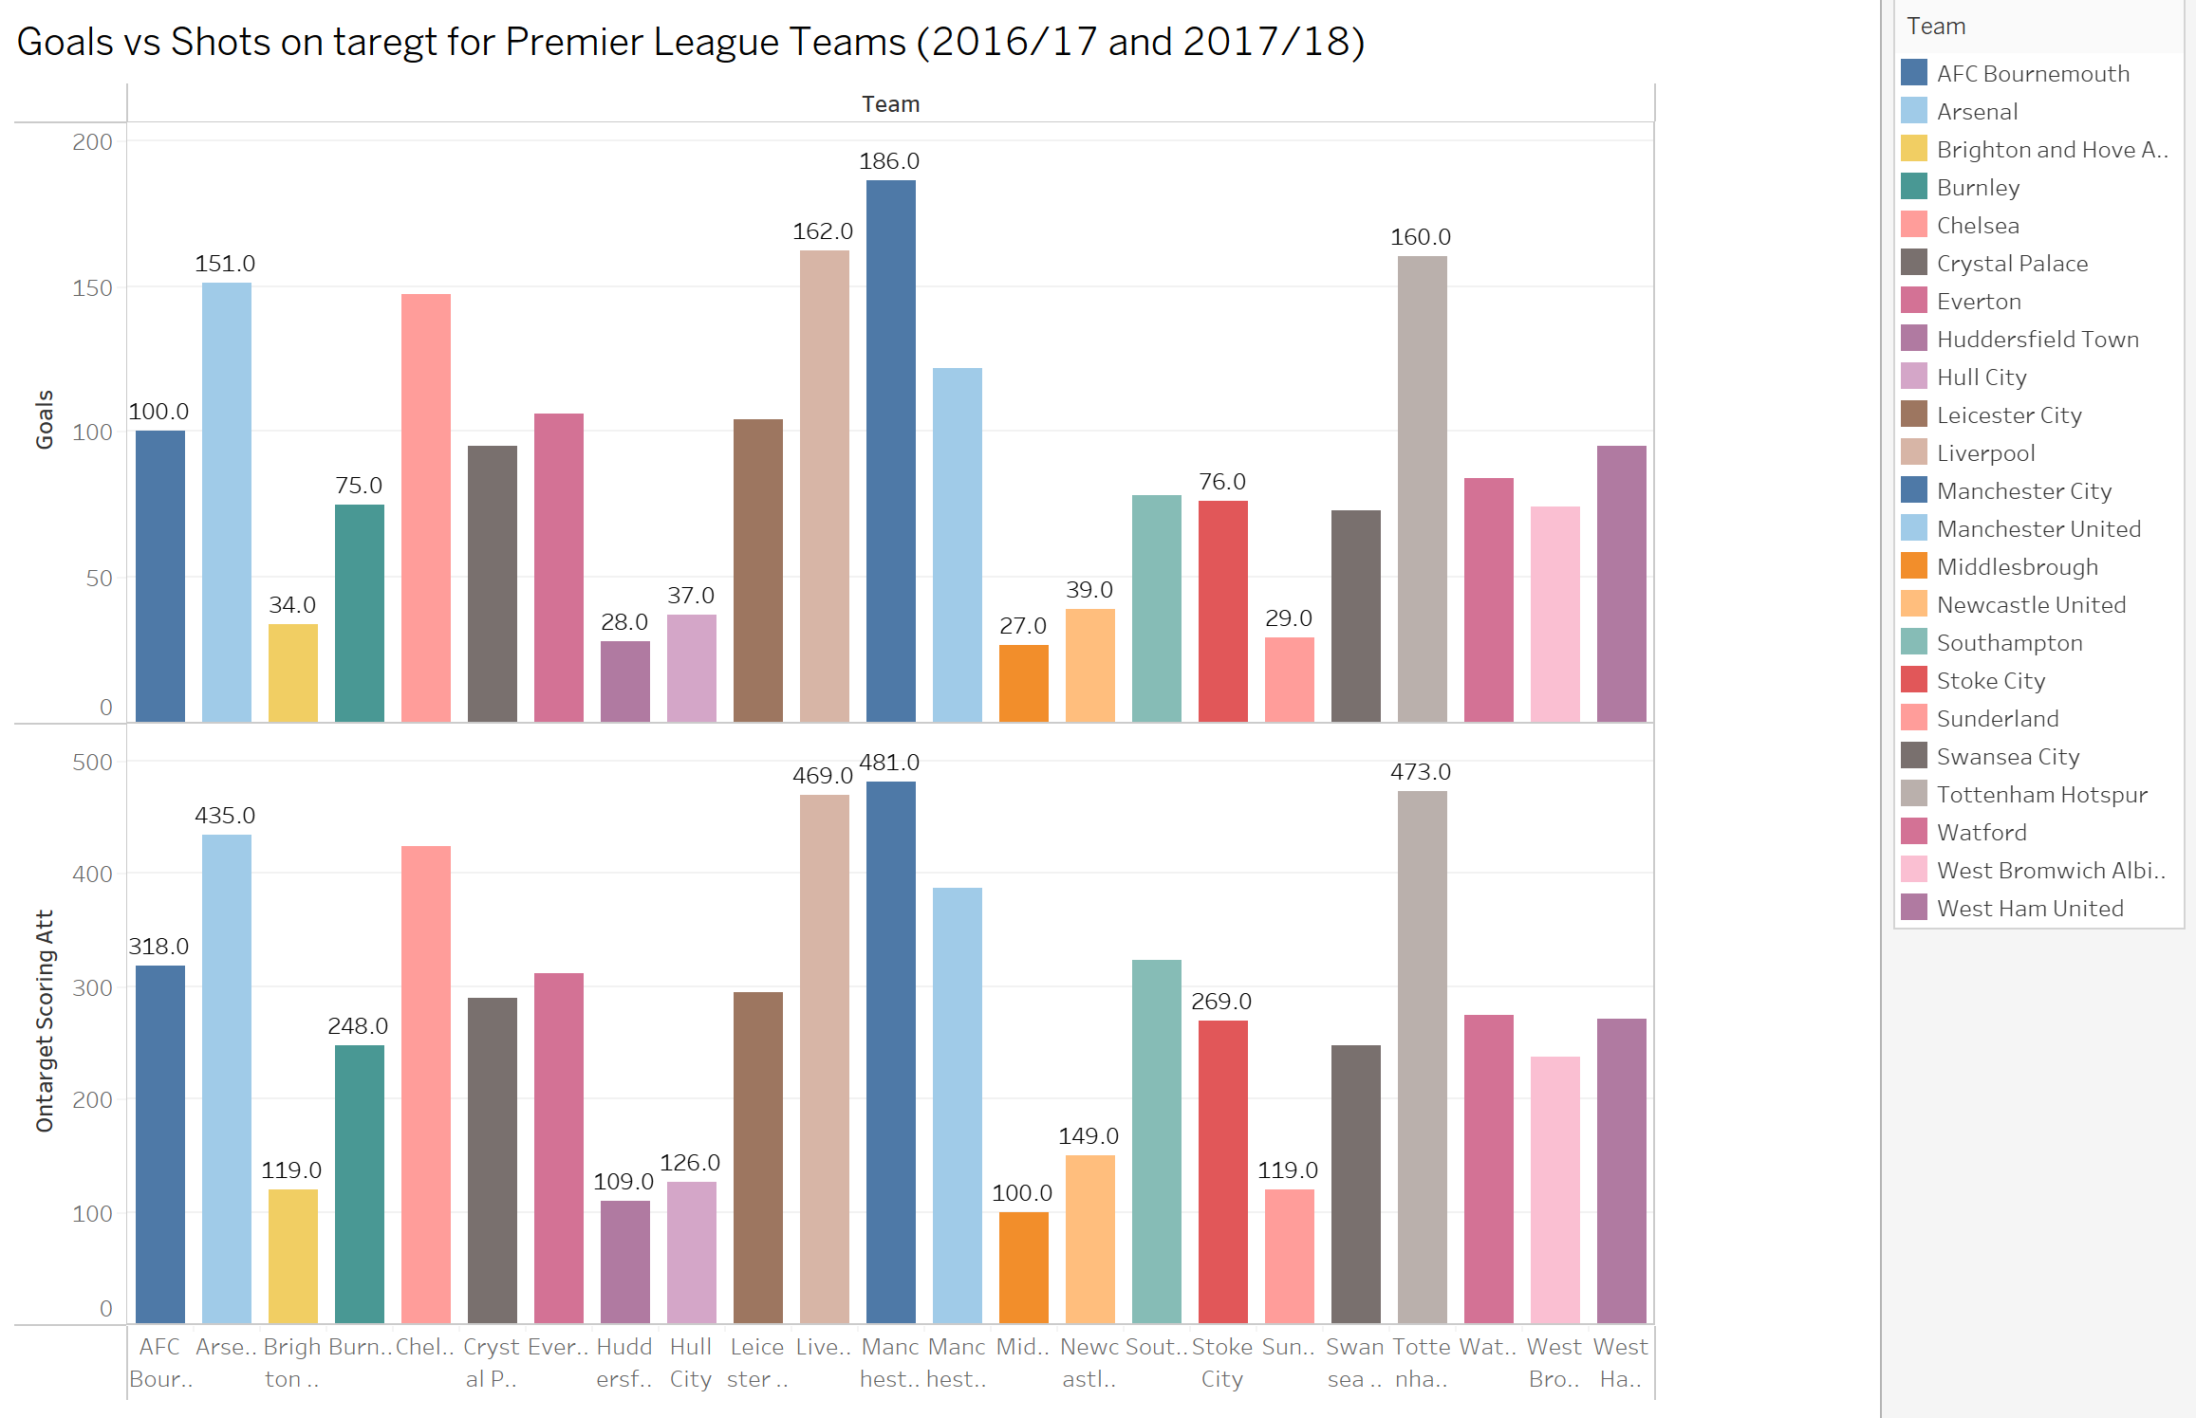
Data analysis and visualisations
Do teams with the highest number of goals also record the highest number of shots on target, and is there a strong relationship between the total passes and goals scored by Premier League teams?
Shots on Target and Goals Positive correlation: More shots on target, more goals.
Top performers: Manchester City(186 goals ,491 shots), Liverpool(162 goals,469 shots)
Struggling teams: Middlesbrough(100 shots,27 goals)

Slide 5
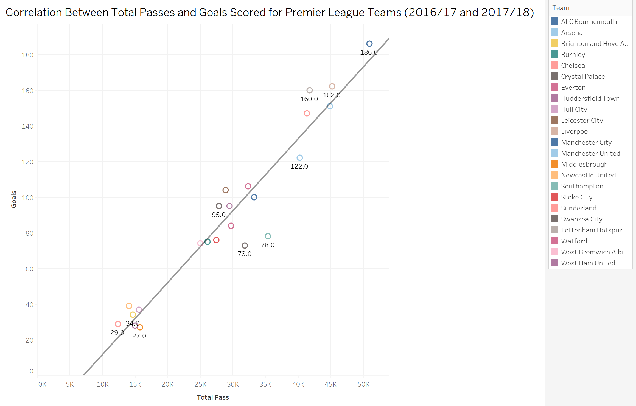
Strong correlation: More passes, more goals.
Possession-based success: Manchester City (28,000 passes , 186 goals), Liverpool (23000 passes, 162 goals)
Low possession, low goals: Sunderland(12000) passes ,29 goals), Hull City (15500 passes ,37 goals)

Slide 6
Key Insight:
Attacking efficiency: Teams need to create more chances and convert them.
Possession-based strategy: Controlling the ball can lead to more scoring opportunities.
Player selection: Focus on players with strong passing and finishing abilities.
Potential Strategies for Underperforming Teams:
Improve shot accuracy: Train players to be more clinical in front of goal.
Increase possession: Implement a more possession-based style of play.
Target key players: Identify players who can create and score goals.

Slide 7
Data Mining Algorithm
I chose the J48 Decision Tree algorithm for its:
Suitability for classification tasks
Interpretability
Ability to handle multiple attributes
Prefer to k-cluster as uses label data
My chosen algorithm:
Recursively partitions data into subsets
Uses entropy minimization for effective classification
Provides clear decision rules for insight
Justification for J48 Decision Trees because:
They offer actionable insights through clear decision rules
They effectively handle multiple classes (seasons)
They efficiently manage high-dimensional data
They provide fast computation
My pre-processing steps:
Although dataset was already cleaned if it wasn’t I would:
Imputed missing values using mean/median/mode Managed outliers with z-score normalisation/IQR•
Considered feature scaling for normalization
Refined features iteratively for improved performance

Slide 8
Data Mining
Implemented J48 Decision Tree algorithm using:
Iterative refinement
Attribute selection
10-fold cross-validation
Analysis and Results:
Achieved performance improvements:
Increased accuracy from 44.2% to 47.5%
Reduced decision tree complexity (from 77 to 71 nodes)
These were my iteration results
Iteration 1: Baseline model (all attributes) – 44.2% accuracy.
Iteration 2: Refined features – 42.9% accuracy, reduced complexity.
Iteration 3: Optimal model – 47.5% accuracy, balanced performance and simplicity.
Key Predictors attributes Identified: Saves, tackles, interceptions.

Slide 9
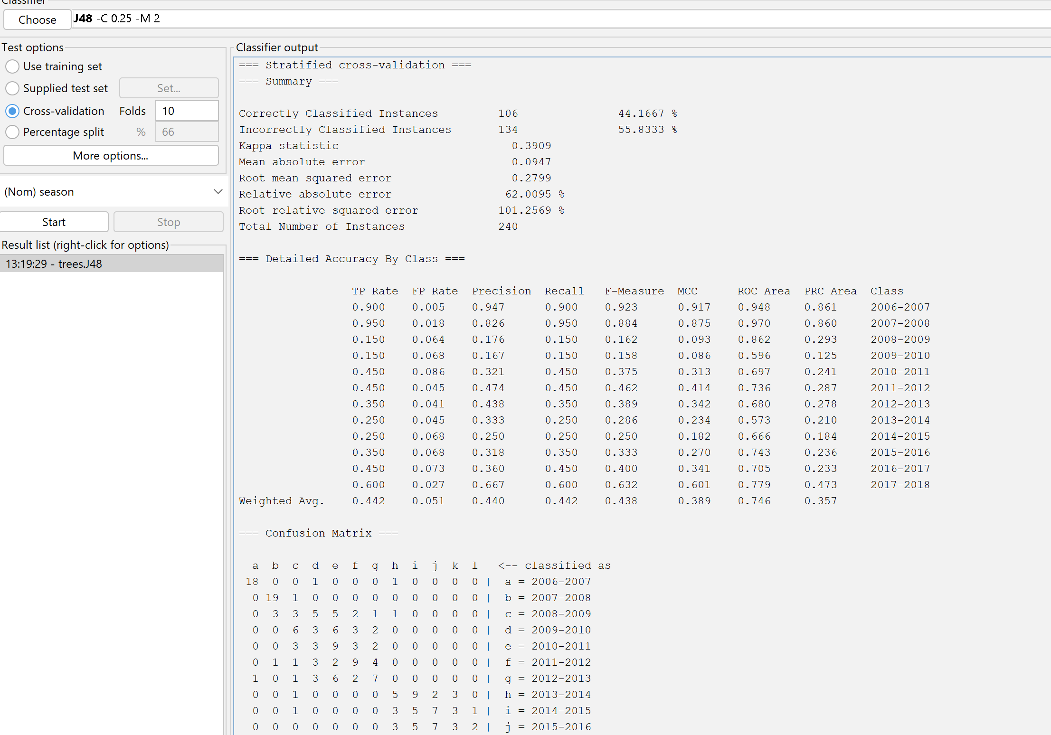
1st iteration

Slide 10
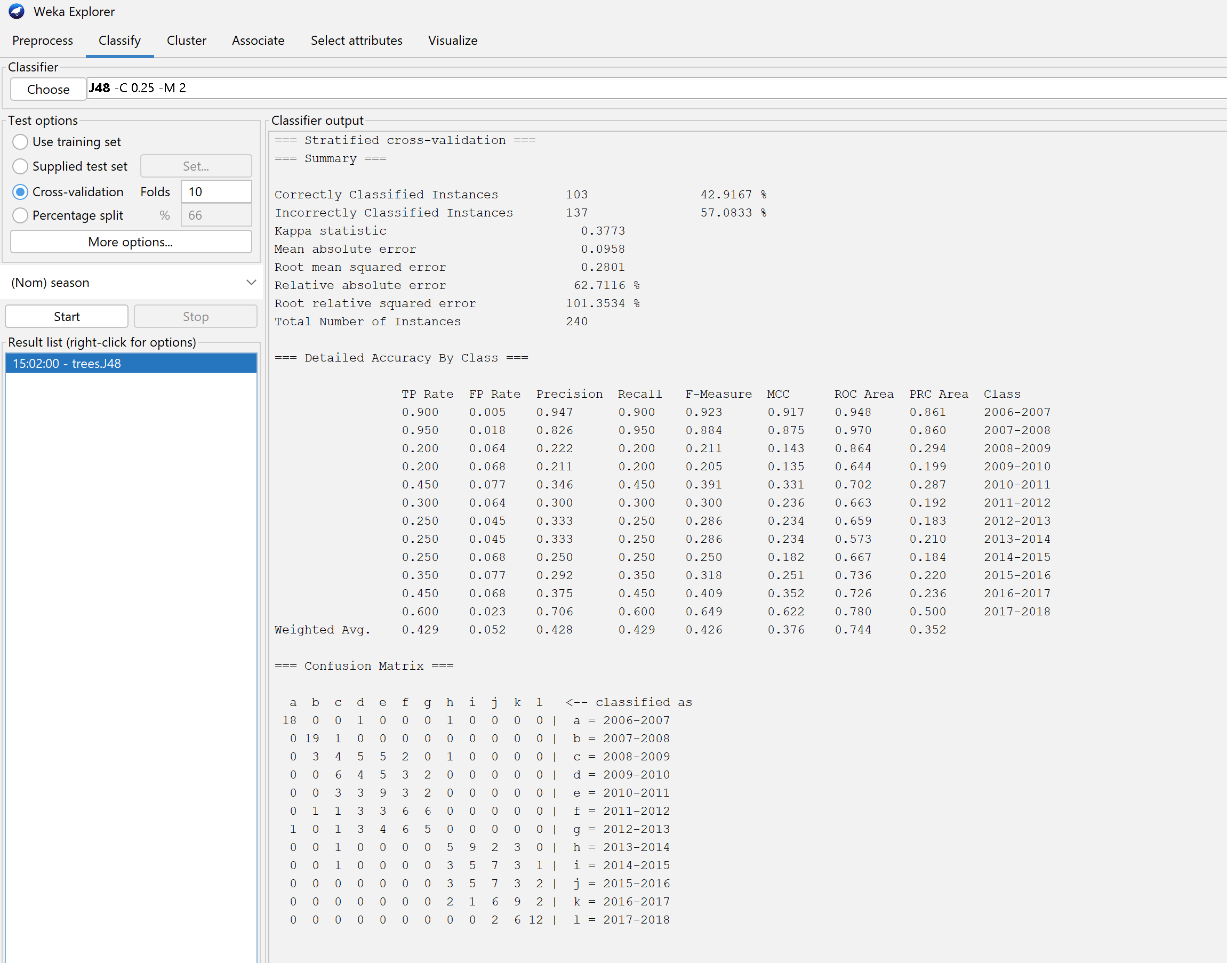
2nd iteration

Slide 11

3rd iteration

Slide 12
Data Mining
Model Fit
Final model characteristics:
Effectively captured general trends
Demonstrated high interpretability
Balanced complexity and performance
Successfully identified key factors influencing Premier League outcomes
Understanding Analysis
Insights gained:
Impact of feature selection on preventing overfitting
Strategies for balancing model complexity and accuracy
Developed actionable insights for team performance analysis
Deeper understanding of algorithm strengths and limitations

Slide 13
Conclusion
Summary of Visualisation Analysis
Key trends and correlations were identified
Such as the relationship between possession (successful passes) and defensive stability (clean sheets).
Outliers like Sunderland highlighted defensive vulnerabilities,
While Manchester City demonstrated the importance of structured, possession-based play.
Summary of Data Mining Analysis:
Using the J48 Decision Tree algorithm, the analysis refined key attributes contributing to team performance.
The final iteration achieved the best balance between simplicity and accuracy,
highlighting variables like total tackles and clean sheets as critical predictors.
Discussion of Relevant BI (Business Intelligence):
These findings provide actionable insights for managers:
Focus on possession-based strategies to improve defence.
Use data-driven insights to enhance player development and tactical adjustments

Slide 14
Questions
?

